Slide 1
Phonon-exciton Interactions in WSe₂ under a quantizing magnetic field
Zhipeng Li#, Tianmeng Wang#, Shengnan Miao#, Yunmei Li#, Zhenguang Lu, Chenhao Jin, Zhen Lian, Yuze Meng, Mark Blei, Takashi Taniguchi, Kenji Watanabe, Sefaattin Tongay, Wang Yao, Dmitry Smirnov, Chuanwei Zhang & Su-Fei Shi
Presenter: Shengnan Miao
2021 March meeting
Published on Nature Communications volume 11, 3104 (2020)
Isermann Department of Chemical and Biological Engineering

Slide 2
Content
Phonon replicas of excitonic particles in monolayer WSe₂
Landau quantization in the PL spectra
Effective mass asymmetry between the electron and hole
Gate-dependent valley-Zeeman shift
Conclusion
Notes:
Today I will talk from the introduction, to our characterization and finally the conclusion

Slide 3
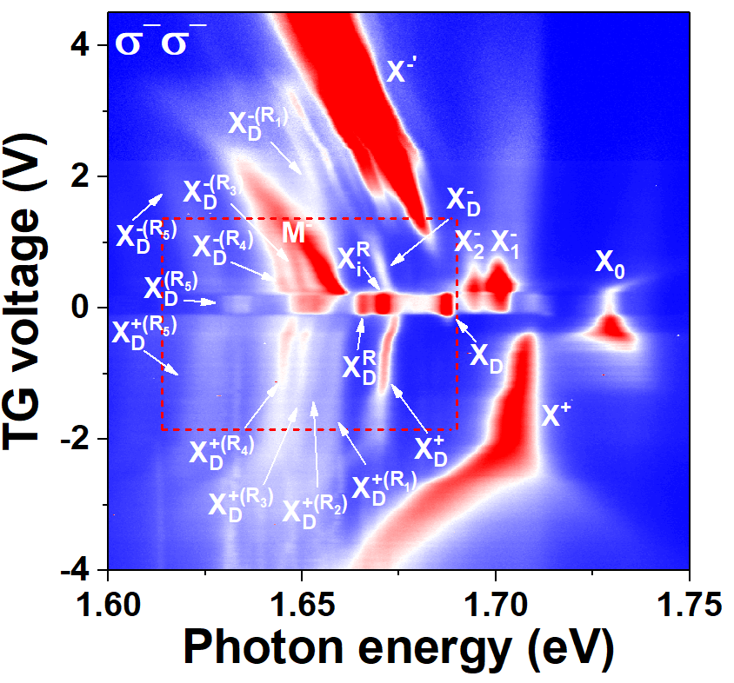
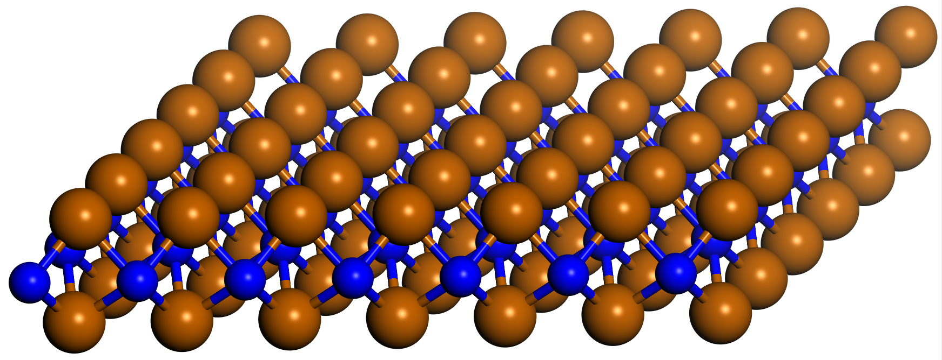
PL spectra of BN encapsulated monolayer WSe₂ at 4.2 K
a
V_{tg}
c
Au
FLG
Au
Au
hBN
WSe₂
SiO₂
Si
b
Contact-Gr
TG-Gr
WSe₂
Bottom-BN
Top-BN
$X_{0}$: bright exciton; $X_{D}:$ dark exciton; $X^{+}:$positive trion; $X_{1}^{−}$: intervalley trion$;$ $X_{2}^{−}$: intravalley trion; $X_{D}^{+}:$ positive dark trion, $X_{D}^{−}:$ negative dark trion; $X_{i}^{R}:$ intervalley exciton–phonon replica; $X_{D}^{R}:$ dark exciton–phonon replica,
Additional emerging excitonic states: $X_{D}^{±\left(R_{1}\right)},X_{D}^{±\left(R_{2}\right)}$, $X_{D}^{±\left(R_{3}\right)}$, $X_{D}^{±\left(R_{4}\right)}$, $X_{D}^{±\left(R_{5}\right)}$
Contact-Gr

Slide 4
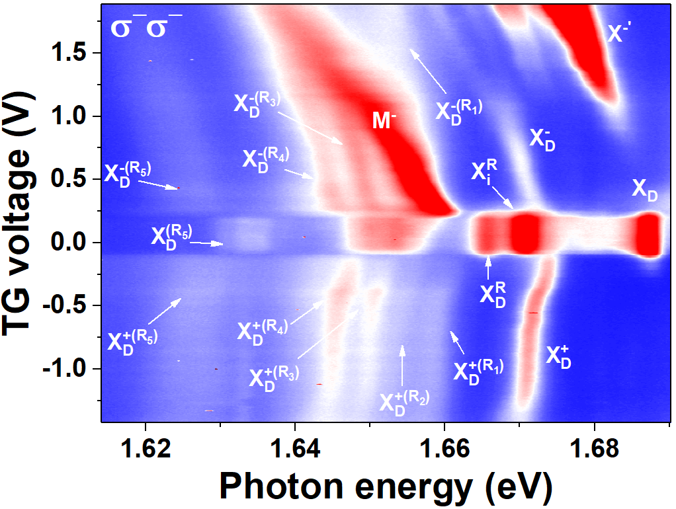
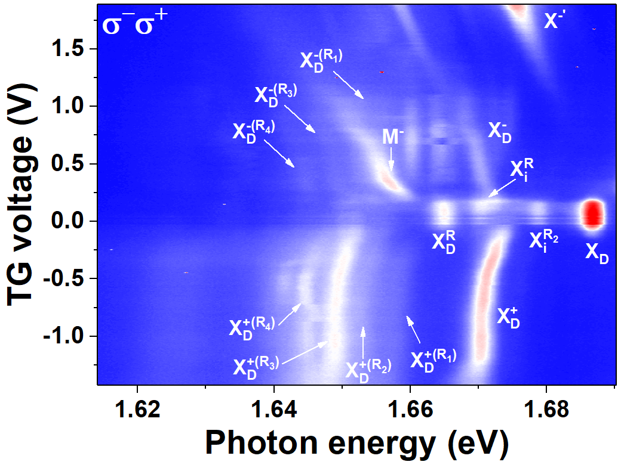
Phonon replicas of the dark trions and phonon modes
a
b
c
¹E’ (K): in-plane longitudinal optical (LO) phonon
¹E’ (K)
²E’ (K)
A’ (K)
E’’ (Γ)
²E’ (K): in-plane transverse acoustic (TA) phonon
A’ (K): in-plane longitudinal acoustic (LA) phonon
$$X_{D}^{−(R_{4})},{ X}_{i}^{R},{ X}_{D}^{+(R_{4})}$$
$$X_{D}^{−(R_{1})}, { X}_{D}^{+(R_{1})}$$
$$X_{i}^{R_{2}}, { X}_{D}^{+(R_{2})}$$
$$X_{D}^{−(R_{3})},{ X}_{D}^{R},{ X}_{D}^{+(R_{3})}$$
E’’ (Γ): phonon at Γ point

Slide 5
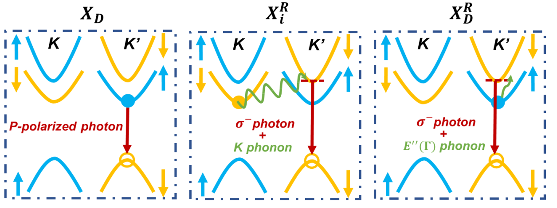
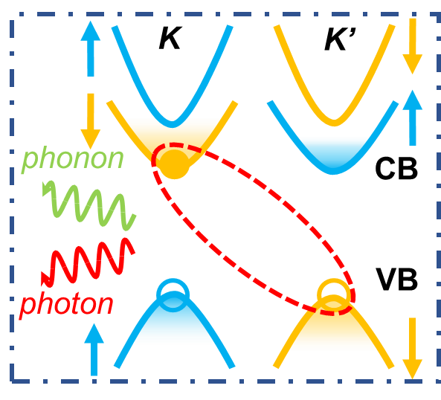
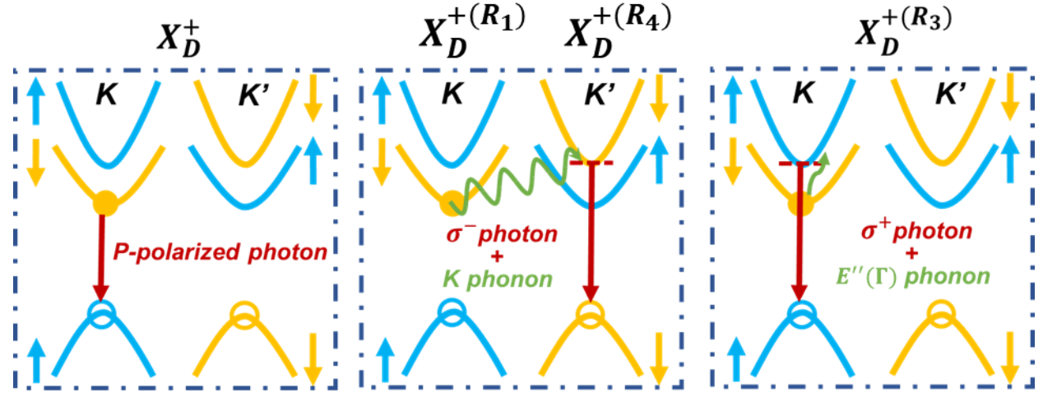
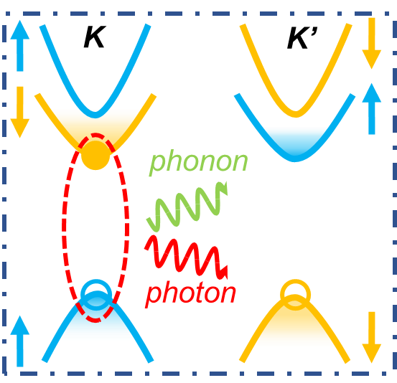
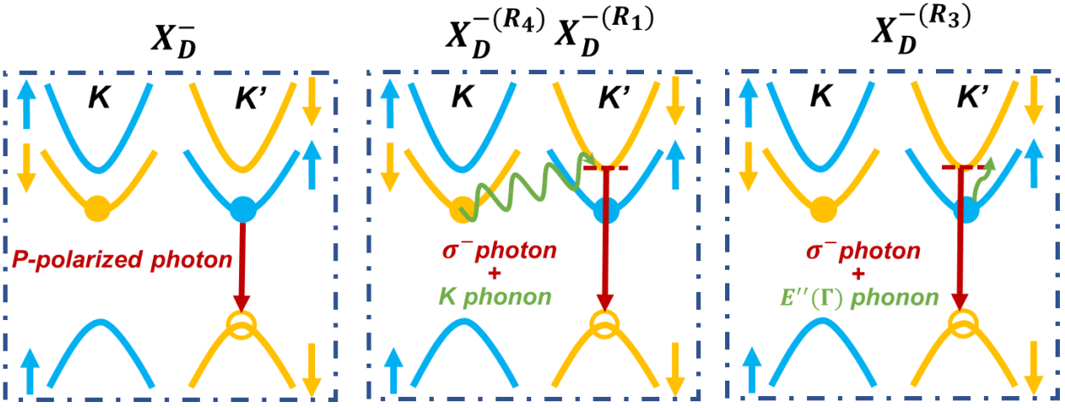
Schematics of the possible recombination paths
through the interlayer electron–hole recombination assisted by emitting a K phonon
1) Charge-neutral region
Intervalley and intravalley scattering through the conduction band
2) Hole-doping region
through the intralayer recombination assisted by emitting a Г phonon
3) Electron-doping region
Notes:
A,b Schematics of light emission from the positive dark trion state through the interlayer electron–hole recombination assisted by emitting a K phonon (a), or through the intralayer recombination assisted by emitting a Г phonon(b)

Slide 6
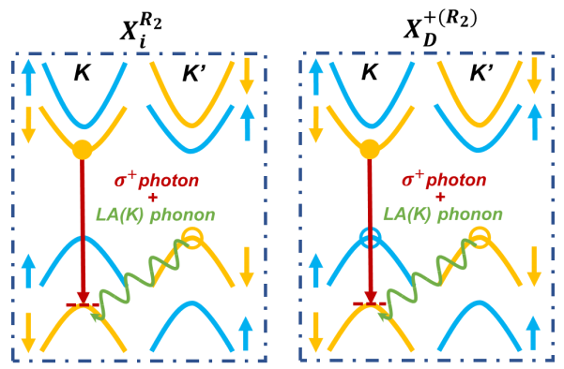
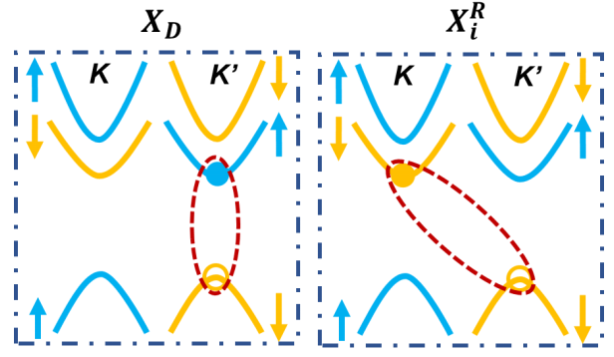
Schematics of the possible recombination paths
Intervalley scattering through valence band
Exchange interaction

Slide 7
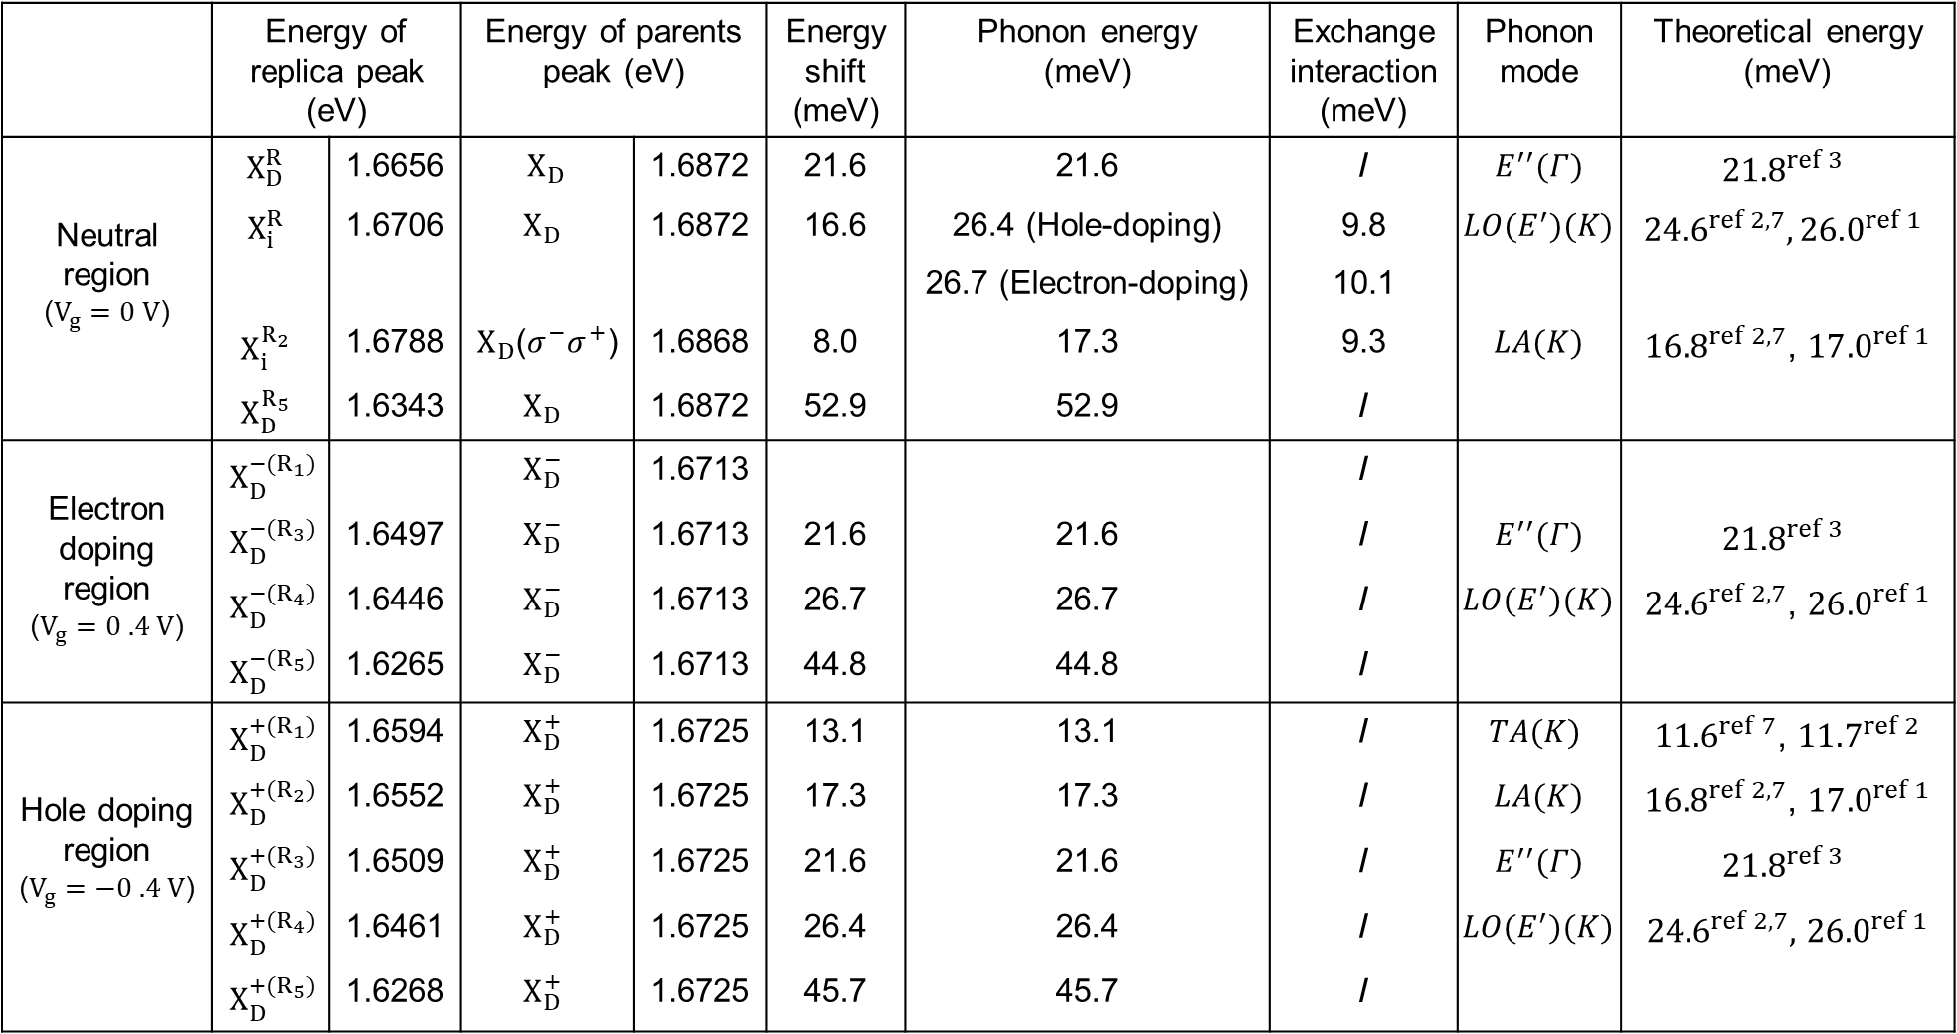

Slide 8
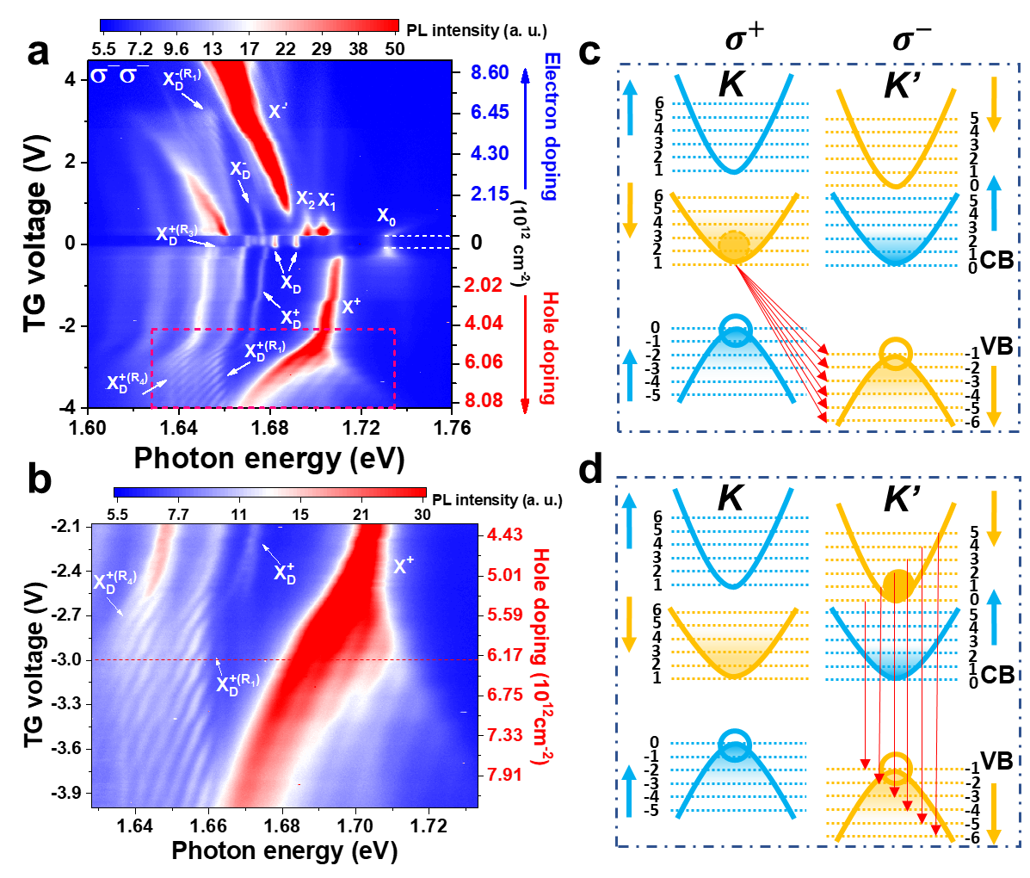
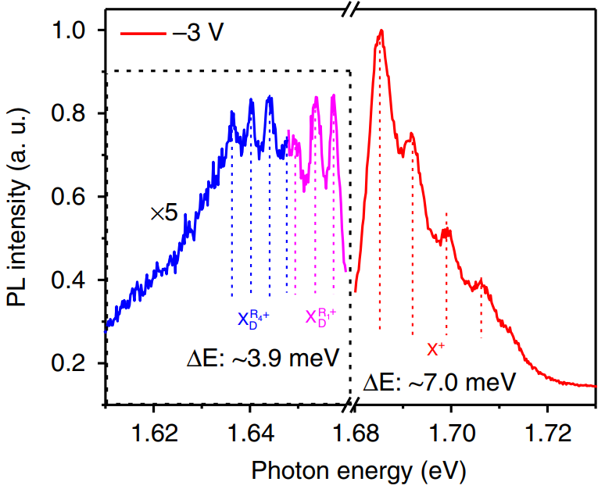
Magneto-PL spectra and Landau quantization
e
the inter-LL transition rate from n in K valley to -n′ in K′ valley:
The selection rule for optical intra-LL transition:
The LL of the exciton:
Effective mass of exciton:
The LL of the hole:

Slide 9
Zeeman shift and many body physics
$$g\sim \frac{m_{0}}{m_{e}}$$
$$g\sim \frac{m_{0}}{m_{h}}$$

Slide 10
Conclusion
In summary, we have shown the observation of Landau quantization of exciton-phonon complexes in monolayer WSe₂ under a large out-of-plane magnetic field.
Further, the unique interaction between phonons and dark excitons in the presence of the valley polarized LLs may shed light on potential avenues of manipulating spin and valley for valleytronics spintronics.
In this work, we find interesting signatures of electron-phonon interaction, Landau quantization and many body effects, which bring many novel and exciting platforms to engineer the strong light-matter interaction.
Notes:
In summary, we report the clearly identification of triplet and singlet through many different spectroscopy study and our work paves the way for future application in valleytronics and spintronics and inspires the future understanding of moire physics in TMDC heterostructure.

Slide 11
Acknowledgement
Advisor
Prof. Sufei Shi
Students:
Tianmeng wang, Zhen Lian, Lei Ma, Kang Li, Yan Li, Mukul Sharma
Postdocs and Visiting Scholars:
Dr. Zhipeng Li, Dr. Dongxue Chen, Yuze Meng
Collaborators:
FSU and NHMFL:
Zhengguang Lu, Dr. Dmitry Smirnov
ASU:
Mark Blei, Prof. Sefaattin Tongay
RPI Center for Materials, Devices, and Integrated Systems

Slide 12
Thanks for watching!

